Slide 1
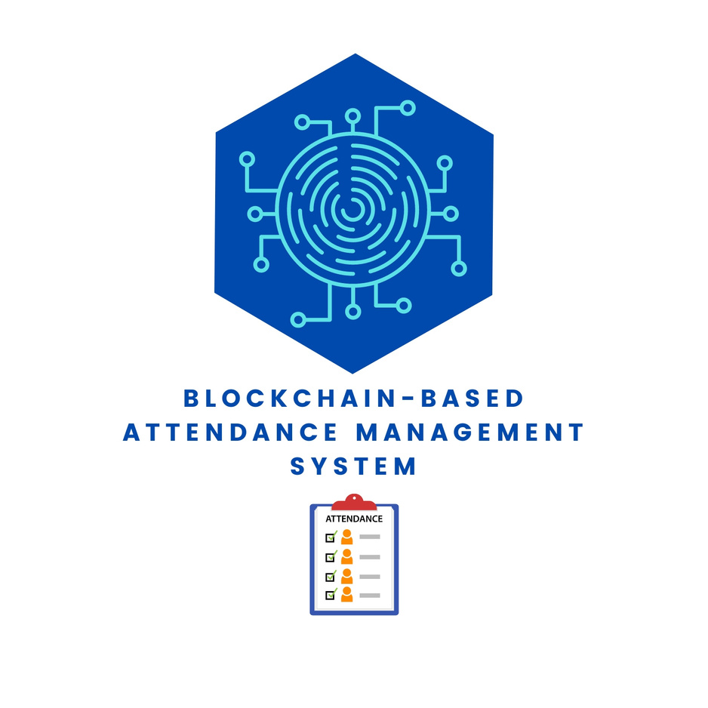
• By Husain Mohammadi Companywala
M.S. College of Arts, Science, Commerce & BMS
Revolutionizing Attendance Management System
Using Blockchain

Slide 2

Introduction
Overview of Attendance Management: Traditional attendance systems rely on manual or centralized methods which are prone to errors, manipulation, and inefficiency.
Blockchain in Attendance Management: Blockchain offers a decentralized, secure, and tamper-proof solution for attendance management.
Importance of the Project: By leveraging blockchain technology, the system enhances transparency, security, and operational efficiency for tracking attendance.

Slide 3
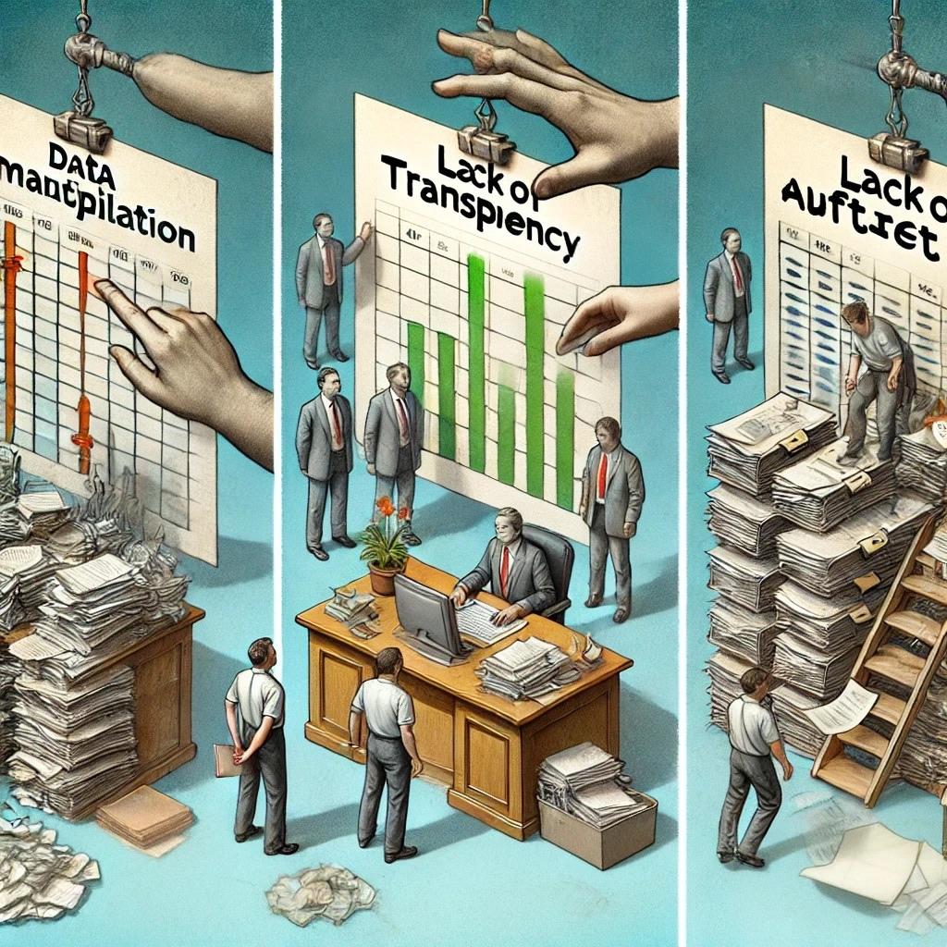
Problem Statement
Challenges with Traditional Systems:
•Manipulation: Data can be falsified, and attendance records are susceptible to tampering.
•Lack of Transparency: There is no clear audit trail, making it hard to verify records.
•Inefficiency: Traditional methods require manual effort, leading to administrative delays.
Notes:
Challenges with Traditional Systems:
• Manipulation: Data can be falsified, and attendance records are susceptible to tampering.
• Lack of Transparency: There is no clear audit trail, making it hard to verify records.
• Inefficiency: Traditional methods require manual effort, leading to administrative delays.

Slide 4

what is Blockchain ?
Definition:
Blockchain is like a digital notebook that keeps a record of transactions (like who did what and when). Once something is written in this notebook, it can never be changed or erased.
Key Characteristics:
Shared Control: No one person owns the notebook; everyone in the group has a copy.
Permanent Records: Once something is written, it stays there forever and can’t be changed.
Everyone Can See: Everyone who has the notebook can see what’s written inside, making everything transparent.
Very Secure: Blockchain uses special codes to keep the information safe from hackers or people who want to cheat.
Use in Attendance:
In our system, every time someone marks their attendance, it gets added to this "digital notebook" (the blockchain) so that no one can change it, and everyone can trust the records.
Notes:
Challenges with Traditional Systems:
• Manipulation: Data can be falsified, and attendance records are susceptible to tampering.
• Lack of Transparency: There is no clear audit trail, making it hard to verify records.
• Inefficiency: Traditional methods require manual effort, leading to administrative delays.

Slide 5

How Blockchain work ?
Step 1: Information is Recorded
A transaction (like a person marking their attendance) is created and added to a list.
Step 2: Data is Grouped into a Block
These transactions are collected together in a "block," which is like a page in a ledger or notebook.
Step 3: Block is Added to the Chain
Once the block is filled with data, it gets added to the "blockchain" (which is like a chain of pages). Every new block is linked to the previous block, forming a continuous chain of records.
Step 4: Secured by Everyone
The information in the block is shared with everyone in the network (people who also have a copy of the blockchain). This makes it impossible for one person to change the data because everyone else has the same copy.
Step 5: Tamper-Proof and Transparent
Once a block is added, it can’t be changed. If anyone tries to alter it, the others will reject the change because they’ll see the data doesn’t match.
Example:
In your attendance system, when a student or faculty member marks their attendance, that entry is stored in a block. Once the block is added to the chain, it can’t be changed, ensuring the attendance records are safe and trustworthy.
Notes:
Challenges with Traditional Systems:
• Manipulation: Data can be falsified, and attendance records are susceptible to tampering.
• Lack of Transparency: There is no clear audit trail, making it hard to verify records.
• Inefficiency: Traditional methods require manual effort, leading to administrative delays.

Slide 6

Why Blockchain?
1. Security:
Blockchain ensures that once data (like attendance) is recorded, it cannot be changed or tampered with. This protects the records from being altered by anyone.
2. Transparency:
Everyone in the system can see the attendance records, so there’s no hiding or altering data behind the scenes. This builds trust between students, faculty, and administrators.
3. Decentralization:
No single person or authority controls the data. It is shared across many computers (called nodes) so that everyone has the same record. This reduces the risk of fraud or manipulation.
4. Immutability:
Once attendance data is added to the blockchain, it is permanent and cannot be modified. This ensures the integrity of the attendance records.
5. Accountability:
Blockchain provides a clear audit trail, which means anyone can verify the authenticity of the records at any time, ensuring that no fake attendance can be marked.
Notes:
Challenges with Traditional Systems:
• Manipulation: Data can be falsified, and attendance records are susceptible to tampering.
• Lack of Transparency: There is no clear audit trail, making it hard to verify records.
• Inefficiency: Traditional methods require manual effort, leading to administrative delays.

Slide 7
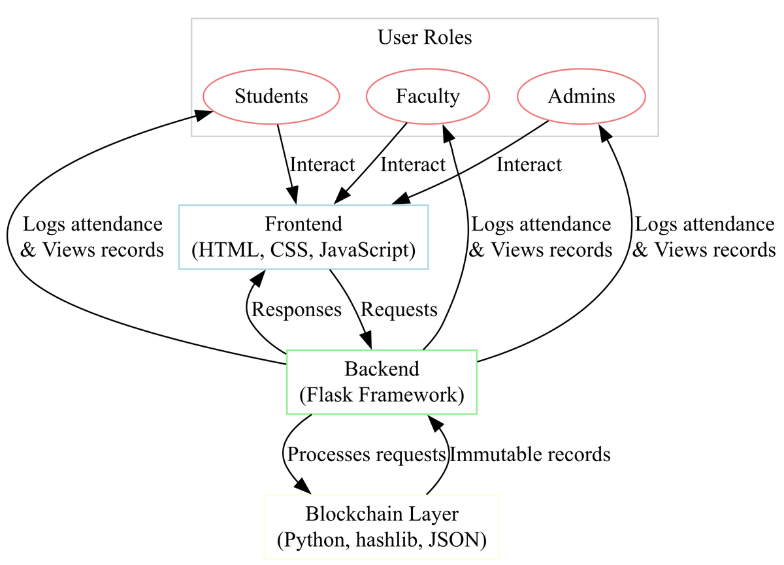
System Architecture
Fronten: This is the part that the users (students, faculty, and admins) interact with. It’s a simple web page where users can log in, mark attendance, or view records. Built using technologies like HTML, CSS, and JavaScript.
Backend: It handles all the requests from the users (like marking attendance) and sends the data to the blockchain. It’s built using Python and a framework called Flask, which helps the web page communicate with the blockchain.
Blockchain Layer: This is where the attendance data is stored securely. Every time someone marks their attendance, it is added to the blockchain, making sure it can’t be changed later.The blockchain is managed using Python, and it ensures all records are safe, secure, and tamper-proof.
Notes:
Challenges with Traditional Systems:
• Manipulation: Data can be falsified, and attendance records are susceptible to tampering.
• Lack of Transparency: There is no clear audit trail, making it hard to verify records.
• Inefficiency: Traditional methods require manual effort, leading to administrative delays.

Slide 8
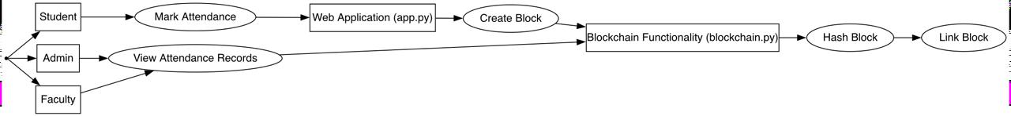
Code Implementation
Blockchain Functionality (blockchain.py):
Block Creation: Each attendance record is added as a new "block." A block stores details like the student’s ID, timestamp, and attendance status.
Hashing: The block is secured using a cryptographic method called hashing. This ensures that once the block is created, it cannot be changed or tampered with.
Chain Linking: Each new block is connected to the previous one, forming a "chain" of blocks, making the entire attendance record history secure and tamper-proof.
Web Application (app.py):
Routes for Different Users:
Admins can log in, view all attendance records, and generate reports.
Faculty can log in and manage attendance for their classes.
Students can mark their attendance through the web interface.
Backend Processing: The app processes the attendance input from users and communicates with the blockchain to store attendance records.
Flask Framework: This is used to connect the frontend (web interface) with the backend, ensuring users can interact with the system in real-time.
Notes:
Challenges with Traditional Systems:
• Manipulation: Data can be falsified, and attendance records are susceptible to tampering.
• Lack of Transparency: There is no clear audit trail, making it hard to verify records.
• Inefficiency: Traditional methods require manual effort, leading to administrative delays.

Slide 9
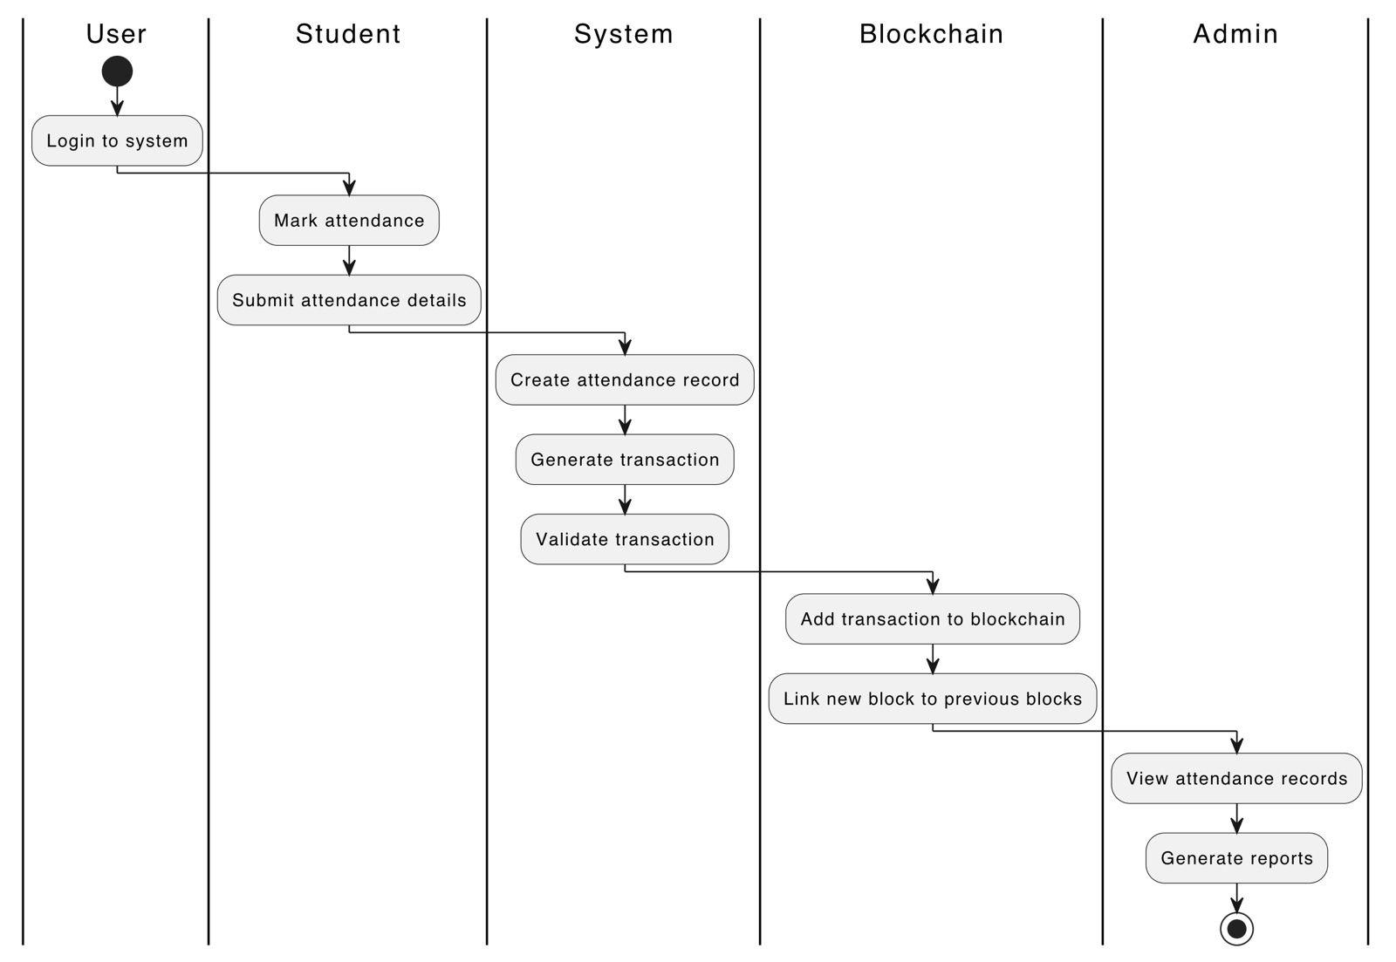
System Architecture
Notes:
Challenges with Traditional Systems:
• Manipulation: Data can be falsified, and attendance records are susceptible to tampering.
• Lack of Transparency: There is no clear audit trail, making it hard to verify records.
• Inefficiency: Traditional methods require manual effort, leading to administrative delays.

Slide 10
Step 1: User Login
Students, faculty, or admin log in to the system using the web interface.
Each user has their own role with specific permissions (students mark attendance, faculty review it, admins manage the system).
Step 2: Attendance Marking
Once logged in, students or faculty mark attendance using a simple button or form on the web interface.
This creates a new attendance record (transaction) with details like user ID, timestamp, and status (present/absent).
Step 3: Transaction Creation
The system creates a transaction that contains the attendance details.
This transaction is added to the blockchain as a new block, ensuring it cannot be changed once added.
Step 4: Validation and Storage
The transaction is validated (checked for authenticity) and added to the blockchain.
The new block is linked to the previous blocks, forming a secure chain of attendance records.
Step 5: Viewing and Reporting
Admins and faculty can view attendance records in real-time.
Reports can be generated based on the stored attendance data, allowing for easy tracking and accountability.

Slide 11
Conclusion
Enhanced Security and Transparency:
Blockchain ensures that attendance data is secure and cannot be tampered with.
Transparency allows all stakeholders to view the records, ensuring trust in the system.
Reduced Administrative Burden:
The automated system reduces the need for manual data entry and verification, saving time for faculty and administrators.
Real-Time Updates:
Attendance records are updated instantly and can be viewed in real-time by authorized users, improving efficiency in tracking attendance.
Impact of Blockchain in Attendance Management:
Blockchain technology ensures that attendance records are permanent and verifiable, solving key problems like manipulation, data loss, and inefficiency.
This project shows how blockchain can improve the accuracy and reliability of attendance systems in educational institutions or workplaces.
Notes:
Challenges with Traditional Systems:
• Manipulation: Data can be falsified, and attendance records are susceptible to tampering.
• Lack of Transparency: There is no clear audit trail, making it hard to verify records.
• Inefficiency: Traditional methods require manual effort, leading to administrative delays.

Slide 12


Husain Companywala

